Slide 1
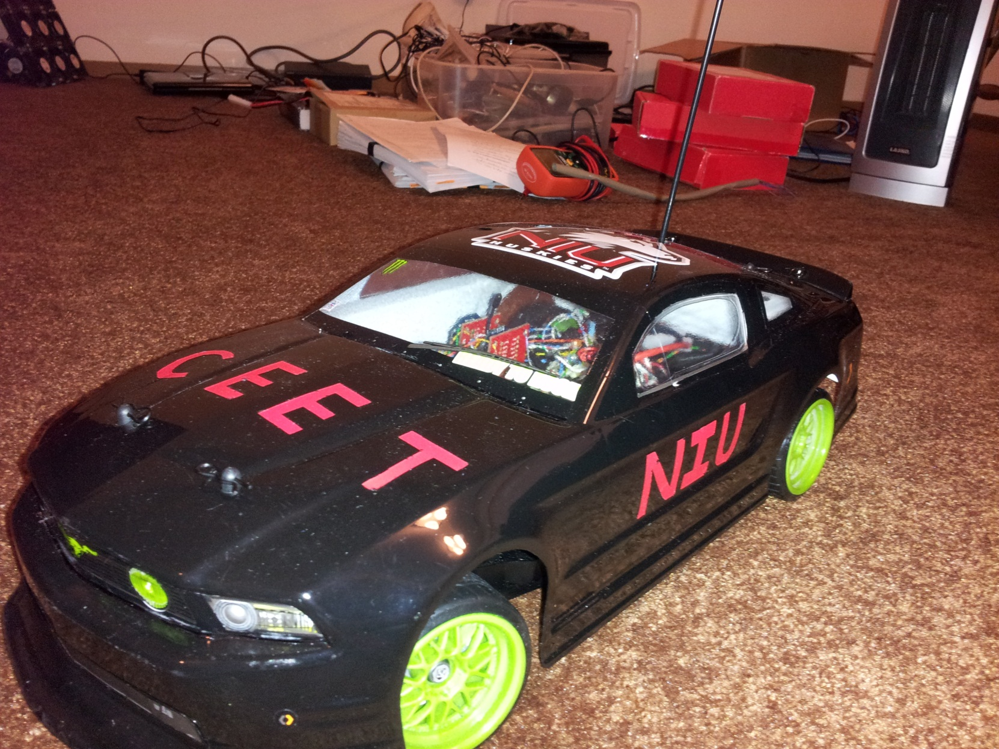
Gyroscopic Vehicle Stabilization
Andrew Moser
Adam Dunsmoor
Hiral Gandhi
Notes:
ADAM

Slide 2
Project Description
Our product is a control system to stabilize vehicles. The users would be automobile drivers and our customers would be automobile manufacturers.
Rear wheel slipping is corrected by adjusting the steering and engine throttle via the onboard microcontroller
  The steering is adjusted by looking at the difference in calculated angular velocity and measured angular velocity
  The throttle decreases when calculated and measured angular velocities don’t match - sliding
The end goal is to make driving safer for all automobile drivers; to reduce accidents, fatalities, and infrastructure damage

Slide 3
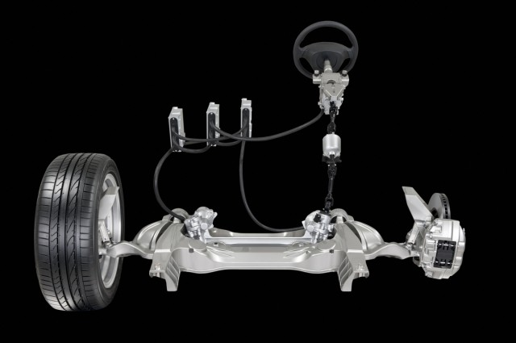
Technology Implementation
Extremetech.com
Notes:
ADAM
This technology caters to drive by wire automobiles
It is drive by wire, but there is a clutch in there, incase if there is a power failure

Slide 4
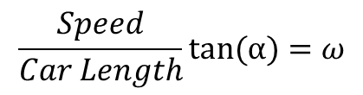

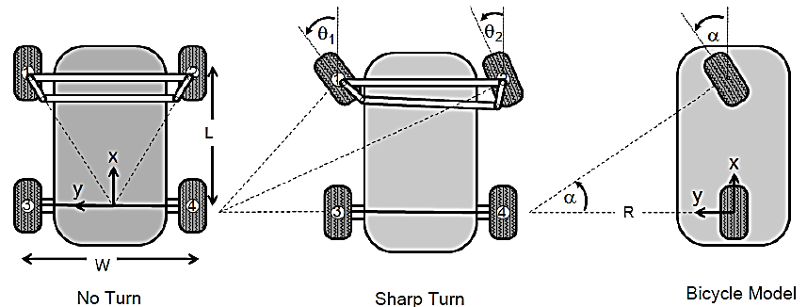
Calculating Angular Velocity
Calculating Angular Velocity (ω) of an Ackermann Steering System
Function fits were used to translate signals to physical characteristics
(Alonzo, pg. 14-15)
Notes:
ADAM
In order to find any error in the vehicle’s angular velocity, a calculated versus measured angular velocity is required.
R is the instantaneous radius of curvature; it relates the curvature to the steering angle α. Since ө1 ≈ ө2 the angles may be closely approximated as α. Since the servo has internal feedback, we assume that it’s able to maintain the target angle of the steering wheels.
Speed is obtained from the wheel encoder and length of the vehicle was found by measuring distance between wheel bases (constant).
With these known, we’re able to calculate our target ω.

Slide 5
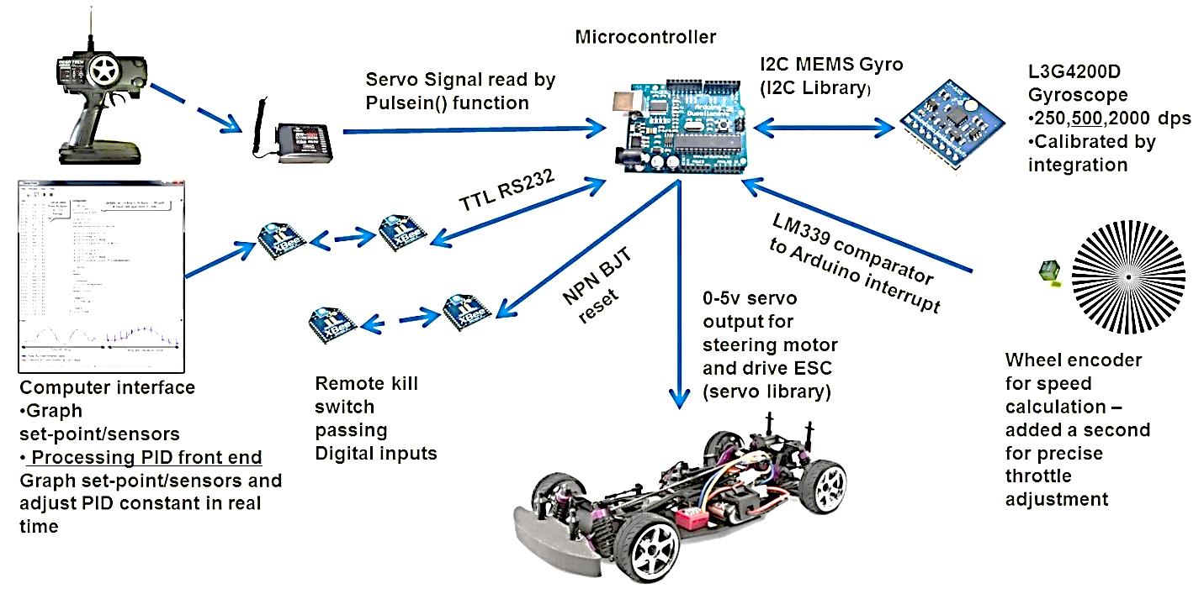
Connection Overview
Notes:
andrew

Slide 6
Flow Diagram
RC Receiver
Σ
Steering Servo
Wheel Encoder
Calculate target
angular velocity
Multiplier
Throttle
PID Setpoint
Gyroscope
PID Input
PID Loop
Notes:
The servo commands are extremely simple to read -- a square wave whose high time is linear to the angle of the servo.
The pulsein() function is used to measure this high time of the servo signal.
A gyroscope is used to measure the rate of rotation of the car's body. According to the datasheet, the MEMs gyroscope will output readings that are close to linear to the actual angular velocity.
To find the multiplication constant the gyroscope’s output was integrated and rotated a known angle (ninety degrees). The output was then scaled to fit in with the ninety degrees angle.
Wheel Encoder: When the wheel rotates, an optical reflectance sensor outputs a voltage that corresponds to the level of light reflected off the encoder. An interrupt was used to measure the time in between dark to light transitions.
To save on measurement complexities the car was pushed a known distance and a proportional function fit was used to calculate the scaling factor for the distance traveled. A derivative approximation was used to calculate the speed, and the speed was integrated to ensure that the calculus approximations were accurate.

Slide 7
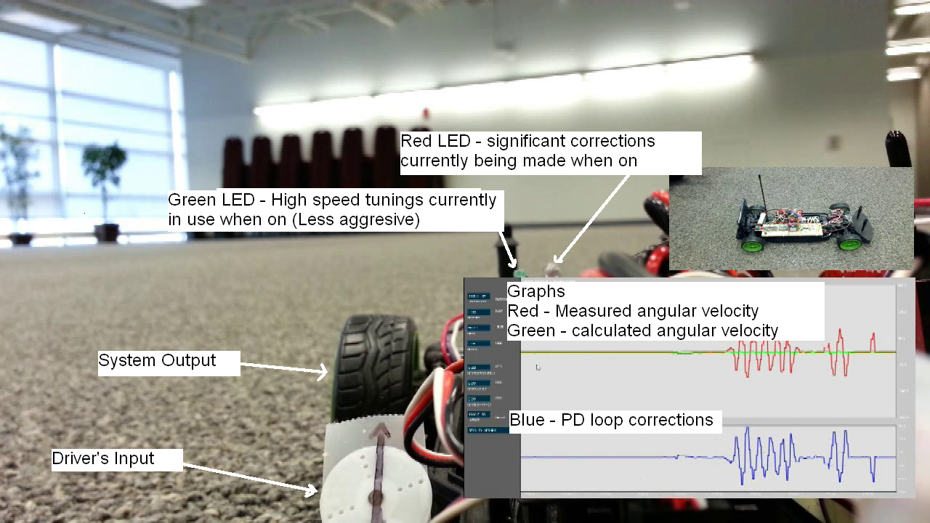
Video Demonstration

Slide 8
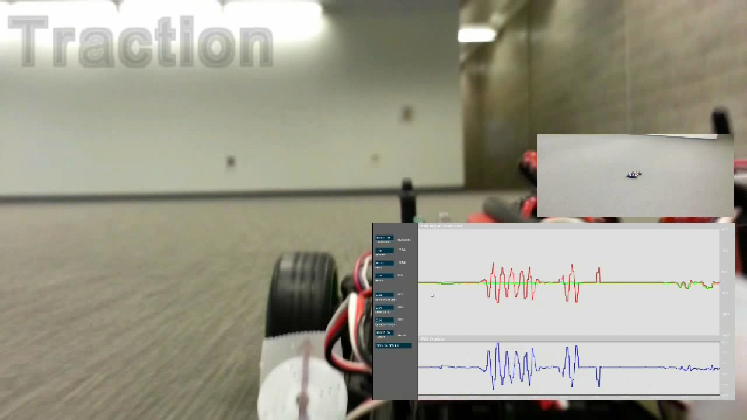
Video Demo - Traction

Slide 9
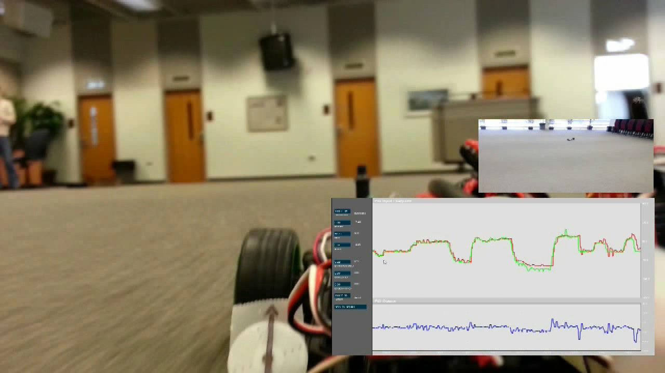
Video Demo - Sliding

Slide 10
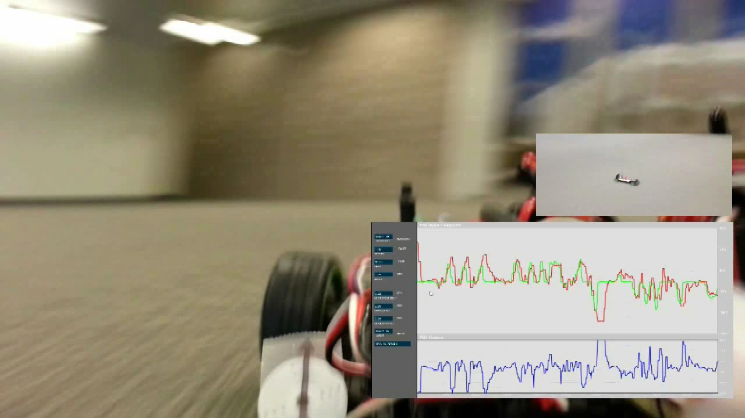
Video Demo - Compensation

Slide 11
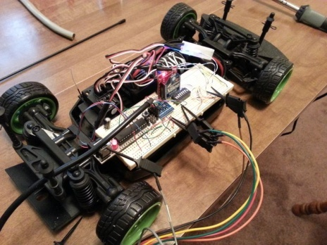
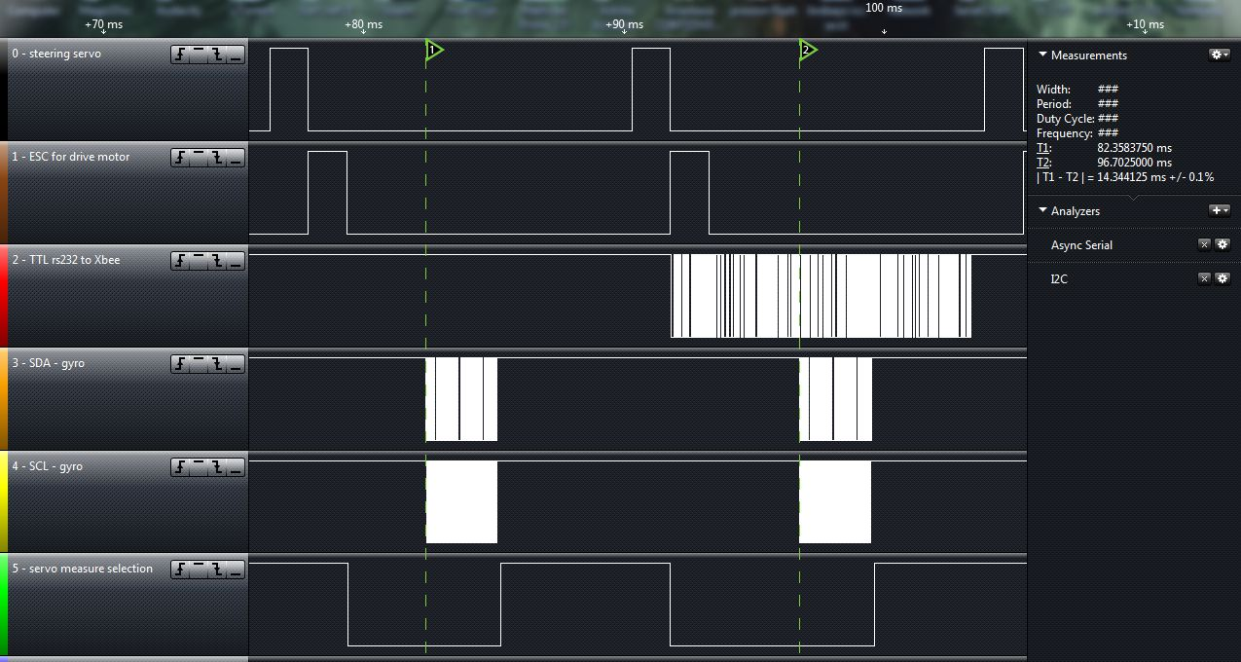
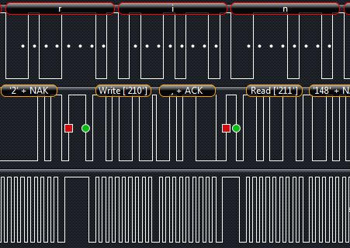
Program loop time
Ensure Code agrees with what’s actually happening
Notes:
HARY
This was done to make sure that the timing agreed with the code
As far as ensuring that the I2C and serial was functioning appropriately, a Saleae logic analyzer was used
Use pin state changes to signal when a certain measurement begins (Green pin)
testing to ensure that the comparator’s hysteresis worked

Slide 12
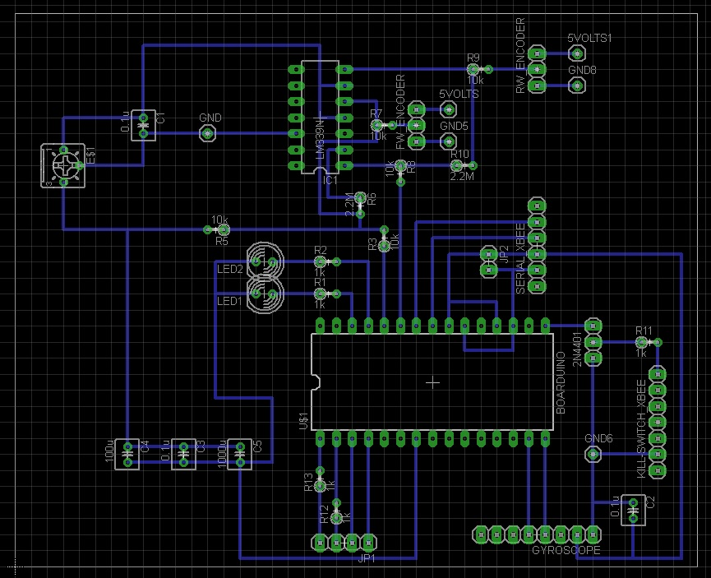
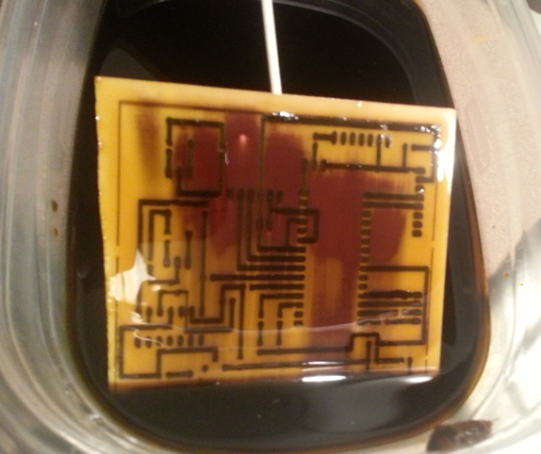
Eagle PCB Design Software
PCB board schematic designed with Eagle Software
To ensure no connections come loose on RC car collisions
To help manage wires, circuit size in chasis, and for overall look
Notes:
HARY

Slide 13
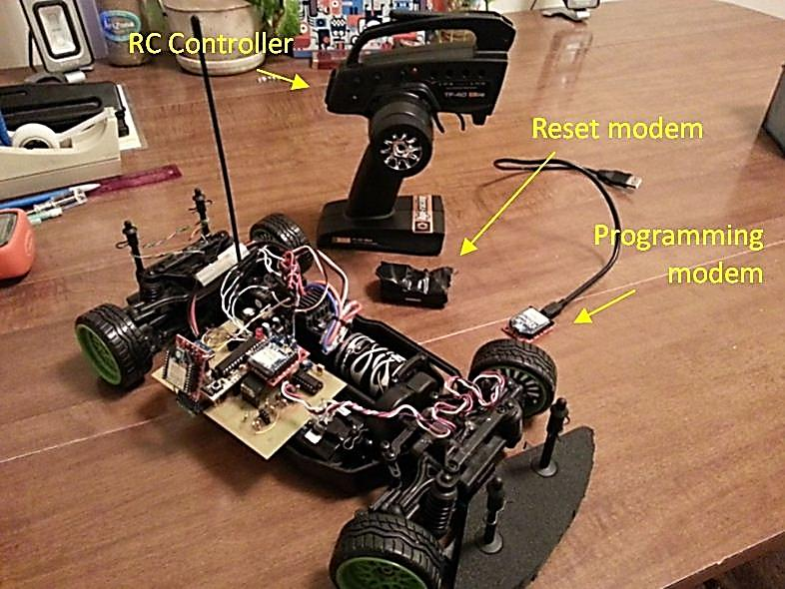
Wireless Components & PCB

Slide 14
Budget
Most components were already owned or loaned for the build requiring little to be purchased.
Description | Cost
RC Drifting Car | $200
Extra RC Car Battery | $20
PCB Board | $20
Miscellaneous Components | $50
Total Cost | $290
Notes:
HARY

Slide 15
Time Line
Week of: | Goal for the week | Goal Met? - notes
Jan 12th | Finalize and order all parts to buy | Y
Jan 20th | Calibrate Gyroscope | Y
Jan 27th | start interfacing all electronics | Y
Feb 3rd | All electronics interfaced and calibrated | Y
Feb 10th | Have all hardware done | Y
Feb 17th | Start writing final program | Y
Feb 24th | Have final program completed | Y
Mar 3rd | Tune control system | Y
Mar 10th | Tune control system | Y
Mar 17th | Take videos and graphs that prove success | Y
Mar 24th | Work on posters and final report until due date | Y
Mar 31st | Finalize design | Y

Slide 16
Conclusion
This senior design incorporates additional control systems to traditional steering systems in an Ackerman steering style car
This solution aims to make driving a safer mode of transportation, introducing control and predictability when the car starts to slide in a fashion that would normally be unpredictable
The overall success and performance of the final system proves that the concept does work
Notes:
HARY

Slide 17
Questions and Answers
Group Contact Information
  Adam Dunsmoor (z1625308@students.niu.edu)
  Andrew Moser (www.reibot.org)
  Hiral Gandhi (hary106@gmail.com)
  Special thanks to free software Eagle PCB and SerialChart
Sources:
Fadali, M. Sam. Digital Control Engineering – Analysis and
Design. Burlington: Academic Press, 2009.
Alonzo, Kelly. A Vector Algebra Formulation of Kinematics
of Wheeled Mobile Robots. Carnegie Mellon
University: 2010.
Notes:
HARY

